Slide 1

Garrett Morgan
Engineering
Innovation
October 7, 2020
Open House

Slide 2




NORMS
Start on time, End on Time
Low tech, high engagement
D
Embrace AND Provide Feedback
Professional Pride
Notes:
Before we dive too deeply into our work together this year and the training we have planned for today, I wanted to share a few norms and expectations to maximize the experience for everyone in the room.
We recognize that our time together is limited, and so we have planned to accomplish a great deal in the time we do have. We will provide breaks during the training and ask that you return on time, so we can start—and end--on time.
We know that you are pulled in a million directions, and thanks to technology, are never too far out of reach from anyone. We understand if you have to take an emergency call, and if so, please step outside as to not disrupt your peers. Otherwise, we aim for today to be low on tech, but very high on your engagement and participation. We have structured today’s learning to be interactive and know from experience that what you put into today will pay dividends for your own professional growth.
We will ask for your feedback and thoughts throughout the day, including a feedback form at the end of the session that we take very seriously. So please let us know how we are doing. Similarly, we may provide you with feedback and we hope you are open and able to work with us to grow your skill as a school leader.
Next, we will try to always assume the best and hope you do the same for us. We all are here to support the students of Cleveland and so even if we disagree at some points today, we know that everyone in this room has the best intentions for our schools and students.
In that same vein, we are proud to be CMSD and want everyone in the room today to think about our collective impact, and the power and responsibility we have to support thousands of teachers and tens of thousands of students.
Lastly, we are fortunate to be in this space today, and ask that you treat it well and leave it cleaner than we found it.
Throughout today’s session, we will bounce between partner work at your tables, discussions amongst the entire group, and presenting information from the front of the room. To gather everyone’s attention, I will raise my hand. When you see my hand raised, please also raise yours and finish your conversation. This will help everyone see that we are coming back together quickly.

Slide 3
Today’s Agenda
Title 1
Attendance
Graduation Requirements
Special Education
Humanware
New School Update
Parent Survey
Mission/ Vision Statement
Notes:
Go over Agenda.

Slide 4
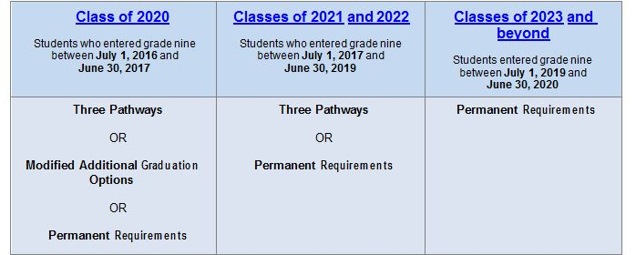

Graduation Requirements
There are many pathways to graduation over the next few years. Please talk to your guidance counsellor to determine the right path for your scholar.

Slide 5

We are a
SAY YES SCHOOL

Slide 6
Say Yes services in 2020-2021
​
Family support specialist for our school who will connect families to support services and resources in our community
Mental health services ​
Free legal services​
Postsecondary Planning System​

Slide 7
SAY YES CLEVELAND: Scholarship Contacts
Say Yes Cleveland scholarships are administered by College Now Greater Cleveland. Questions about Say Yes scholarships, including the Scholarship portal, applications, and payments to schools, can be directed to:
Say Yes Scholarship Hotline: 216.454.5400
SayYesScholarship@collegenowgc.org

Slide 8

Attendance Matters!
What happens when a student misses school?
Missing school significantly and negatively impacts academic achievement. As much as half of the student body misses 10 or more days of school each year.
Data shows that missing 10 or more days of school will:
  reduce reading scores by 12 points
  reduce math scores by 15 points
  reduce a student’s chances of remaining on track to graduation by 34 percent
  Did you know?
As early as kindergarten, excessive absence can cause children to fall behind.
Early absences lead to difficulties and poor attendance in later years.
One in 10 kindergarten and first-grade students nationally is chronically absent, missing a month of school.

Slide 9
What you can do as a parent or caregiver to encourage your child
Ask your child if he or she is learning every day and if they feel safe in school. If your child is having negative experiences, call or visit your school to address the issues with educators.
Monitor your child’s academic progress and seek help from educators or tutors if necessary.
Make sure your contact information is up-to-date with your school.
Talk with your child about the importance of getting to school every day and make it the expectation.
Help your child maintain daily routines.
Sign the Family Attendance Pledge.

Slide 10
Special Education
Special Education is a continuum of services and supports designed for children who have disabilities that impact their academic performance.
All schools in CMSD are staffed with at least one Intervention Specialists.
Every neighborhood offers specialized single classrooms for intensive needs.
All schools have access to speech/language therapy, occupational therapy, physical therapy, and other related services.
Specialized single classrooms for intensive needs at multiple schools throughout the city [school shares which programs/classrooms are available at that particular school.
Contact the Special Education Department at 216.838.7733.
Follow on Twitter: @ALLinCMSD

Slide 11
Humanware/Social and Emotional Learning (SEL)
5 SEL Competencies and Levels of School wide SEL
FAMILY & COMMUNITY PARTNERSHIPS
SCHOOL WIDE PRACTICES & POLICIES
SEL CURRICULUM & INSTRUCTION
SOCIAL AWARENESS
RESPONSIBLE DECISION MAKING
SELF MANAGEMENT
RELATIONSHIP SKILLS
SELF AWARENESS
Social and Emotional Learning (SEL)

Slide 12
Cleveland Metropolitan School District
SEL Strategies, Programs and Initiatives
High Schools
Student Advisory Committees
N.O.W. Anti-Bullying
W.A.V.E. Conflict Mediation
Planning Centers
Student Support Teams
Rapid Response/Crisis Response
Class Meetings
School-based Mental Health
Closing the Achievement Gap (CTAG)
Quality Standards
Conditions for Learning Survey
Pre-K-8 Schools
PATHS – Grades Pre-K-5
Second Step – Grade 6 - 8
N.O.W. Anti-Bullying
W.A.V.E. Conflict Mediation
Planning Centers
Student Support Teams
Class Meetings
School-based Mental Health
Rapid Response/Crisis Response
Quality Standards
Conditions for Learning Survey

Slide 13

Project Act – Homeless Services
Project ACT provides direct instructional and support services to children and youth residing in temporary emergency shelters, transitional housing and doubled-up students staying with other families due to loss of housing, economic hardship or similar situations.
A holistic and comprehensive approach is used to deliver instructional and support services necessary to facilitate the homeless child's transition into school, and to ensure the child's success and ongoing participation in the educational system.
Support services include everything necessary to accomplish the goal of meeting students' physical, social and emotional needs, and empowering parents to support their children in this endeavor. All appropriate resources from the Cleveland Metropolitan School District are employed to achieve this goal.
Call 216.838.0201 for more information.

Slide 14

Multilingual Multicultural Education Department
For more information, Please call us at 216.838.0140
Multilingual Multicultural Education Department is tasked in making sure that all CMSD’s English Learners receive the appropriate language learning services alongside continuing grade level content learning and teaching. Academic English language learning focuses on developing literacy and proficiency listening, speaking, reading and writing.
The Multilingual Multicultural Education Department not only ensures the education of all English learners in CMSD, but also:
  Provides enrollment and language assessments for students whose first language is not English;
  Family and student support services in several languages;
  Translation and interpretation services;
  Assists with home and school connections, and facilitates communication and school options/choices;
  Helps with families and students in crisis.

Slide 15
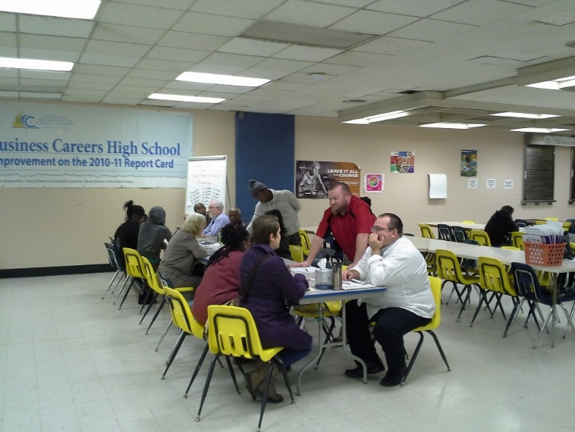
Parent Teacher Conferences
Last year 90.8% of parents and caregivers in CMSD attended parent teacher conferences. Our school achieved 87%
Parent Teacher Conferences are a great way to connect with your child’s teachers and partner with them to support achievement.
Our first conferences will be on (Thursday, October 24, 2019)

Slide 16
What is the purpose of Title- I, Part A?
Family Engagement Federal Funding
  To inform parents of their rights and roles within their scholar's school building as it relates to:
    decision making
    allocation of funds towards engagement activities
  To inform parents of the programs supported by Title One in their building.
  Ensure that the Cleveland Metropolitan School District engages in a two-way communication with parents.

Slide 17
What is supported by Title- I, Part A ?
Instructional Aides
Instructional Coaches
Additional Teachers
Technology for students
Reading and Math programs
Family Engagement - Our school receives dollars for family engagement programs and activities to support our school priorities
Notes:
* We will only be covering the Parental Engagement portion of Title One funds.

Slide 18
Parents' Right to Know -Title IA, ESSA
Parents have the right to know about the teaching qualifications of their child's classroom teacher in a school receiving Title I funds. You can request this information from your principal:
Notification if your child is being taught for 4 or more weeks by a teacher who is not highly qualified.
Whether the teacher has met state qualification and licensing criteria for the grade levels and subject areas in which the teacher provides instruction
Whether the teacher is teaching under emergency or other provisional status through which State qualification or licensing criteria have been waived
Whether the teacher is teaching in the field of discipline of certification of the teacher
Whether your child is provided services by paraprofessionals and, if so, their qualifications

Slide 19
How can I support
Title One initiatives?
Volunteer in your scholar’s school
Participate in the SPO (School Parent Organization) or Parent Advisory Committee
Ask to participate in the development of the Academic Achievement Plan (AAP)
Attend Title I sponsored programs and activities
Support your child’s learning by creating a space for them to do homework and exposing them to resources and enrichment opportunities in the community
Participate in family engagement activities and programs sponsored by the district like Parent University college tours and classes
For more information contact the Office of Family and Community Engagement @ 216.838.3223

Slide 20
Mission
Relationships
Rigor
Results

Slide 21
Vision
Garrett Morgan’s Mission is…………
Garrett Morgan High School students will be academically prepared and socially motivated to enter the ever-changing world as responsible and productive global citizens.

